Slide 1
Forge.mil OSS Methodologies/Consumption
Guy Martin, Aaron Lippold
Forge.mil Community Management Team
community@forge.mil

Slide 2



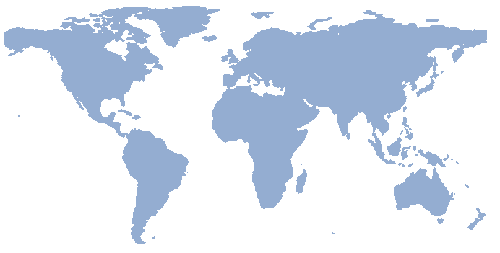
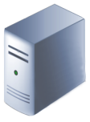

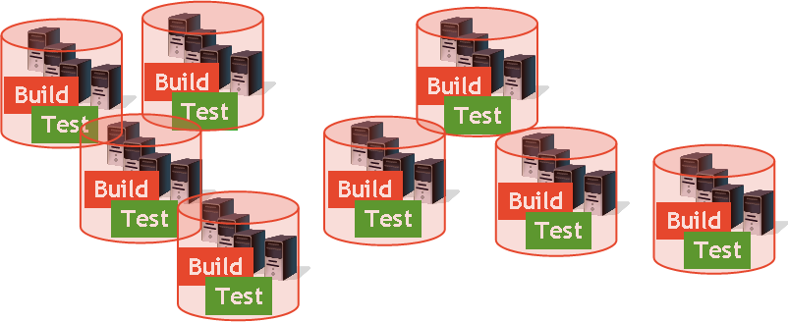
Forge.mil
Shared Asset
Libraries & Repositories
TODAY
Siloed development environments
Expensive and time consuming start-up
Limited exposure, sharing, or re-use
Duplication of effort
TODAY
Siloed development environments
Expensive and time consuming start-up
Limited exposure, sharing, or re-use
Duplication of effort
Tester
Developer
Developer
Shared Test & Development Tools/Services/Environments
Certifier
User
FORGE.mil
Agile development and testing
Cross-program sharing: software and services
Early and continuous collaboration
Integrated approach to development life cycle
Extensible platform to support delivery of partner capabilities

Slide 3
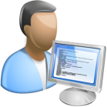



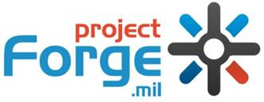

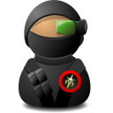


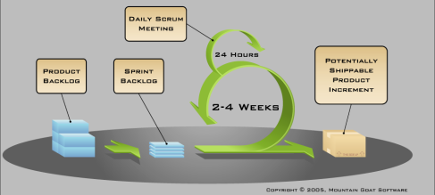


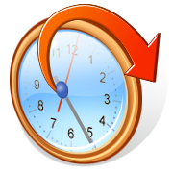


Forge.mil Vision
Forge.mil Community –
Stakeholders and SMEs
Collaborative Development/Test Environment
Improve DoD’s ability to rapidly deliver dependable Software, Services and Systems
Developers
Users
Program Managers
Cloud Computing Services
Testers
Warfighters
SME
Process and Methods
Tools and Resources
Community Shared Knowledge and Best Practices
Continuous Integration
Agile Software Development
Continuous Delivery
Testing Services

Slide 4




Forge.mil Family of Services
Community
Collaborative content and knowledge management site for Forge.mil users to connect and share information
Free, collaborative development environment for open-source and DoD community source software
On-demand, fee-for-service, development environment for individual programs and projects
Forge.mil != DoD’s Open Source Interface

Slide 5

Tools are Great, But…
Culture Has to Change To Fulfill Promise!

Slide 6

OSS Methods/Consumption Being Driven…
By the wave of economic pressure
DoD Budget Cuts
Gov Data Center Consolidation
Greater Acquisition Oversight
‘Cloud First’ Strategy

Slide 7
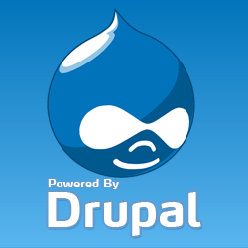
Forge.mil Responds By…
Utilizing Open Source To Add a ‘Social Dev’ Space
‘Community Layer’ Build Out
Integration with Project Tools (ALM)
Basic Reputation Management
Cross-project Collaboration Areas
Larger Communities of Interest

Slide 8
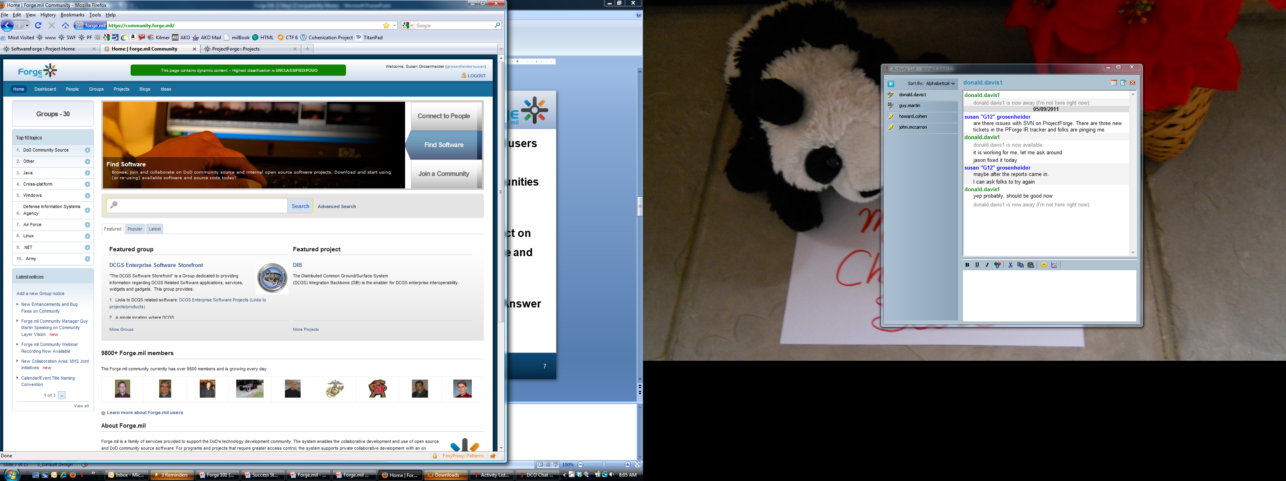
Forge.mil Community Value
Connect with other Forge.mil users
Find Software/Projects
Discover and join sub-communities or Groups
Improve Collaboration
Share Ideas or find Ideas to act on
Share Knowledge, Experience and Lessons Learned
Find Answer and Solutions
Cast a Wider Net to Find the Answer
Expand the Discussions
See the Bigger Picture

Slide 9
Forge.mil Community Profile
Notes:
Access to Forge.mil
Forge.mil is available to U.S. military, DoD government civilians and DoD contractors for Government authorized use. Access to Forge.mil requires a valid DoD Common Access Card (CAC) or a PKI certificate issued by a DoD approved External Certificate Authority (ECA) with a DoD government sponsor. Your Forge.mil account provides you access to all Forge.mil sites – the Forge.mil Community, SoftwareForge and ProjectForge.
Forge.mil Community
Forge.mil Community is a collaborative content and knowledge management site for Forge.mil users to connect and share information using social collaboration tools such as group blogs, discussions, wiki, documents and polls. While the project teams on SoftwareForge and ProjectForge are focused on their individual project or projects, the Forge.mil Community site provides teams/individuals working to solve similar problems and/or discuss similar challenges that transcend a single project or set of projects a means to self organize around these challenges to develop common solutions.
Forge.mil Community is currently integrated with SoftwareForge ‘public’ projects. Development to include private projects is currently planned for a future Community release.
SoftwareForge
The first offering launched in April 2009 was SoftwareForge. The goal for SoftwareForge was to model the best of the open source communities in terms of doing collaborative development and bring that into the DoD by offering the same set of capabilities and enable the same set of approaches that have been driving successful open source projects. What makes SoftwareForge unique from other traditional reuse efforts is rather than simply posting your software as a static item for download and use by end users, you enable ongoing collaborative software development by making your software available, allowing others to contribute updates, provide feedback, report bugs and issues and allowing for a continuous evolution of the software – adapting the software to different environments and growing the software with new functionality and usefulness. SoftwareForge enables the collaborative development and distribution of open source software and DoD community source software.
ProjectForge
After SoftwareForge rolled out, there were project teams stating they had a need for the same toolset for projects and teams that were unable to operate in the open. They wanted the same tools in a private project space. Teams that required greater access control, teams that did not have intellectual property rights necessary to share software, teams that wanted greater control over the core platform functionality in terms of site branding, project templates, and custom extensions were asking for private project space.
ProjectForge provides the same application life cycle management tools to DoD projects and programs as SoftwareForge, but for projects that are not doing DoD community source development and/or need to restrict access to specific project members. While SoftwareForge comes free to valid users, ProjectForge is a fee for service capability, provided on demand from a DoD data center, operated by DoD cleared personnel, and operated to DoD requirements in regards to Information Assurance and operations support.

Slide 10
Forge.mil Community Dashboard
Notes:
Access to Forge.mil
Forge.mil is available to U.S. military, DoD government civilians and DoD contractors for Government authorized use. Access to Forge.mil requires a valid DoD Common Access Card (CAC) or a PKI certificate issued by a DoD approved External Certificate Authority (ECA) with a DoD government sponsor. Your Forge.mil account provides you access to all Forge.mil sites – the Forge.mil Community, SoftwareForge and ProjectForge.
Forge.mil Community
Forge.mil Community is a collaborative content and knowledge management site for Forge.mil users to connect and share information using social collaboration tools such as group blogs, discussions, wiki, documents and polls. While the project teams on SoftwareForge and ProjectForge are focused on their individual project or projects, the Forge.mil Community site provides teams/individuals working to solve similar problems and/or discuss similar challenges that transcend a single project or set of projects a means to self organize around these challenges to develop common solutions.
Forge.mil Community is currently integrated with SoftwareForge ‘public’ projects. Development to include private projects is currently planned for a future Community release.
SoftwareForge
The first offering launched in April 2009 was SoftwareForge. The goal for SoftwareForge was to model the best of the open source communities in terms of doing collaborative development and bring that into the DoD by offering the same set of capabilities and enable the same set of approaches that have been driving successful open source projects. What makes SoftwareForge unique from other traditional reuse efforts is rather than simply posting your software as a static item for download and use by end users, you enable ongoing collaborative software development by making your software available, allowing others to contribute updates, provide feedback, report bugs and issues and allowing for a continuous evolution of the software – adapting the software to different environments and growing the software with new functionality and usefulness. SoftwareForge enables the collaborative development and distribution of open source software and DoD community source software.
ProjectForge
After SoftwareForge rolled out, there were project teams stating they had a need for the same toolset for projects and teams that were unable to operate in the open. They wanted the same tools in a private project space. Teams that required greater access control, teams that did not have intellectual property rights necessary to share software, teams that wanted greater control over the core platform functionality in terms of site branding, project templates, and custom extensions were asking for private project space.
ProjectForge provides the same application life cycle management tools to DoD projects and programs as SoftwareForge, but for projects that are not doing DoD community source development and/or need to restrict access to specific project members. While SoftwareForge comes free to valid users, ProjectForge is a fee for service capability, provided on demand from a DoD data center, operated by DoD cleared personnel, and operated to DoD requirements in regards to Information Assurance and operations support.

Slide 11
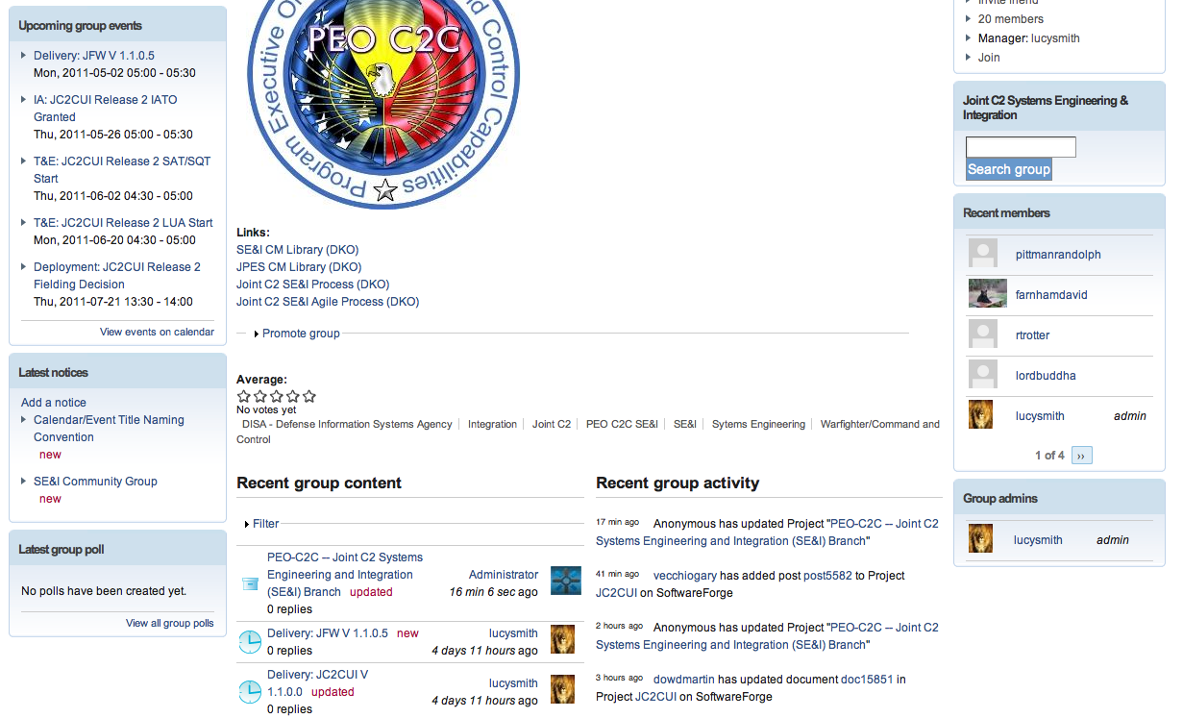
Forge.mil Community Group Tools
Notes:
Access to Forge.mil
Forge.mil is available to U.S. military, DoD government civilians and DoD contractors for Government authorized use. Access to Forge.mil requires a valid DoD Common Access Card (CAC) or a PKI certificate issued by a DoD approved External Certificate Authority (ECA) with a DoD government sponsor. Your Forge.mil account provides you access to all Forge.mil sites – the Forge.mil Community, SoftwareForge and ProjectForge.
Forge.mil Community
Forge.mil Community is a collaborative content and knowledge management site for Forge.mil users to connect and share information using social collaboration tools such as group blogs, discussions, wiki, documents and polls. While the project teams on SoftwareForge and ProjectForge are focused on their individual project or projects, the Forge.mil Community site provides teams/individuals working to solve similar problems and/or discuss similar challenges that transcend a single project or set of projects a means to self organize around these challenges to develop common solutions.
Forge.mil Community is currently integrated with SoftwareForge ‘public’ projects. Development to include private projects is currently planned for a future Community release.
SoftwareForge
The first offering launched in April 2009 was SoftwareForge. The goal for SoftwareForge was to model the best of the open source communities in terms of doing collaborative development and bring that into the DoD by offering the same set of capabilities and enable the same set of approaches that have been driving successful open source projects. What makes SoftwareForge unique from other traditional reuse efforts is rather than simply posting your software as a static item for download and use by end users, you enable ongoing collaborative software development by making your software available, allowing others to contribute updates, provide feedback, report bugs and issues and allowing for a continuous evolution of the software – adapting the software to different environments and growing the software with new functionality and usefulness. SoftwareForge enables the collaborative development and distribution of open source software and DoD community source software.
ProjectForge
After SoftwareForge rolled out, there were project teams stating they had a need for the same toolset for projects and teams that were unable to operate in the open. They wanted the same tools in a private project space. Teams that required greater access control, teams that did not have intellectual property rights necessary to share software, teams that wanted greater control over the core platform functionality in terms of site branding, project templates, and custom extensions were asking for private project space.
ProjectForge provides the same application life cycle management tools to DoD projects and programs as SoftwareForge, but for projects that are not doing DoD community source development and/or need to restrict access to specific project members. While SoftwareForge comes free to valid users, ProjectForge is a fee for service capability, provided on demand from a DoD data center, operated by DoD cleared personnel, and operated to DoD requirements in regards to Information Assurance and operations support.

Slide 12
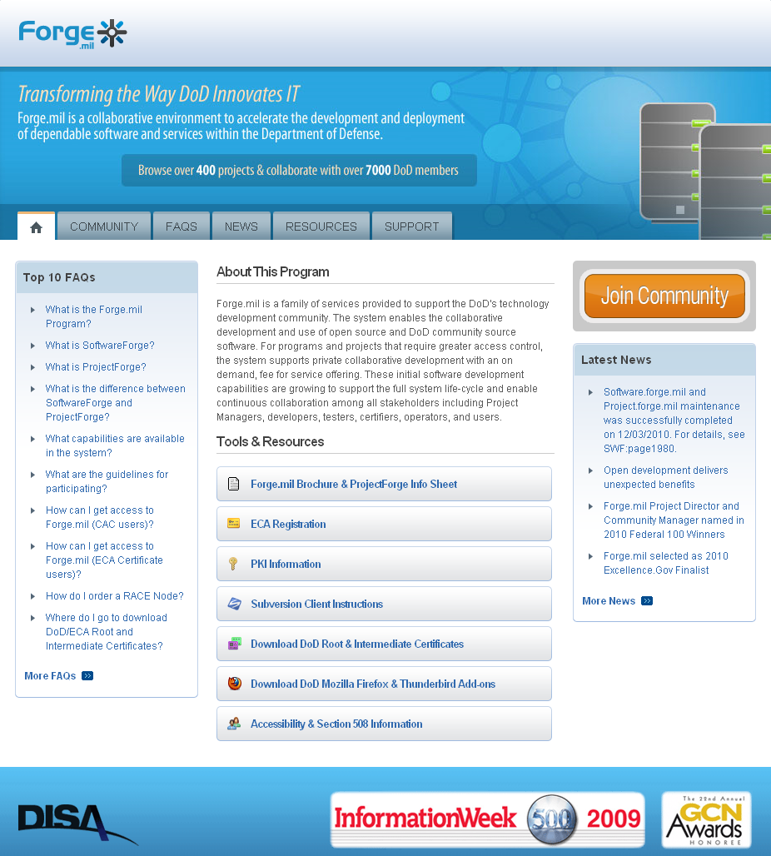
The Forge.mil Community Forge.mil by the Numbers
Over 10,000 DoD developers, IT experts, and users sharing lessons learned, best practices, and solutions
Over 500 development efforts
Over 50 sub-communities
Over 4,400 software releases
Community Contributions
57,000 software commits
51,000 downloads
4,000 discussion posts
15,000 documents
3,500 wiki pages
1,000 software repositories
and Growing . . .

Slide 13




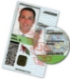
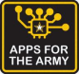







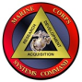
Community Participation
Joint Organizations
Distributed Common Ground/Surface System (DCGS) Integration Backbone (DIB)
National Senior Leader Decision Support Service (NSLDSS)
Chemical, Biological, Radiological and Nuclear (CBRN) Software
DoD Cloud Computing Strategy – collaborative development/implementation of DoD Strategy
Community CAC – provides guidance and tools for using the Common Access Card
Army
Apps 4 Army: Innovation challenge to develop new ‘mashups’ of Army data
System of Systems Common Operating Environment (SOSCOE) – tactical middleware
Tank and Automotive Research, Development and Engineering Center Software Engineering Center – Mine Resistant Ambush Protected Digital Backbone
Navy
Naval Undersea Warfare Center (NUWC)
Joint Explosive Ordnance Disposal Decision Support System (JEOD DSS)
Air Force
Air and Space Operations Center Weapon System (AOC WS) Modernization
Sensor Processing Architecture for Data Exploitation (SPADE)
Marine Corps
Distributed Common Ground/Surface System – Marine Corps (DCGS-MC)
Marine Air Ground Task Force Command and Control (MAGTF C2)
Notes:
13

Slide 14


Contact Info
Email us at community@forge.mil
Follow us on Twitter @ForgeMil
Sign up for Forge.mil updates at http://www.disa.mil/forge/

